Slide 1
WELCOME TO OUR CARE WEBSITE
MADE BY : MUHAMMAD BIN ADEEL, MUHAMMAD HUZAIFA, MUHAMMAD KHIZAR AND MUHAMMAD ARBAZ.

Slide 2

THIS IS OUR HOME PAGE.

Slide 3

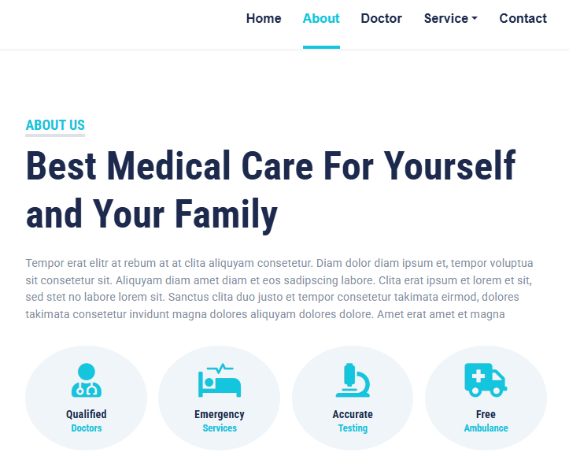
ABOUT US.

Slide 4
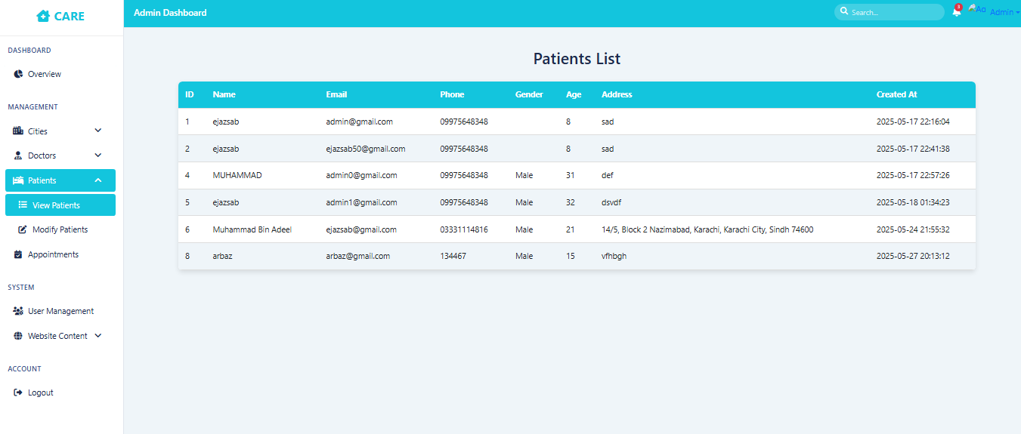
Admin pannel.

Slide 5

OUR DOCTORS.

Slide 6
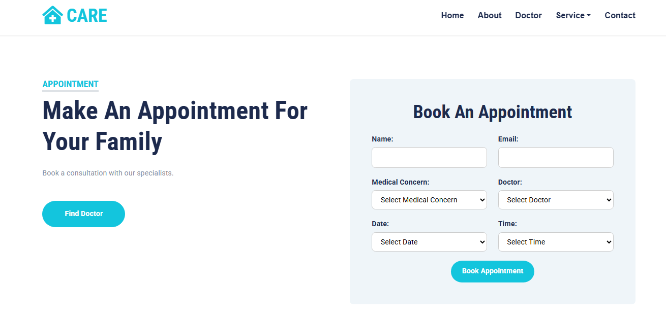
THIS IS APPOINTMENT PAGE.

Slide 7
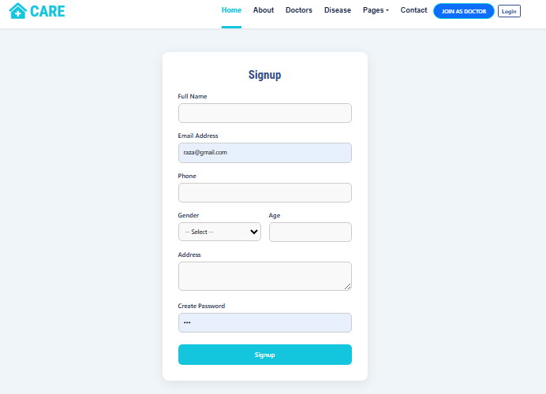
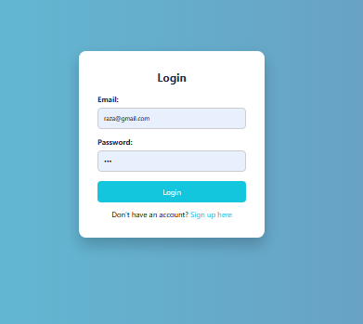
SIGN UP AND LOGIN

Slide 8
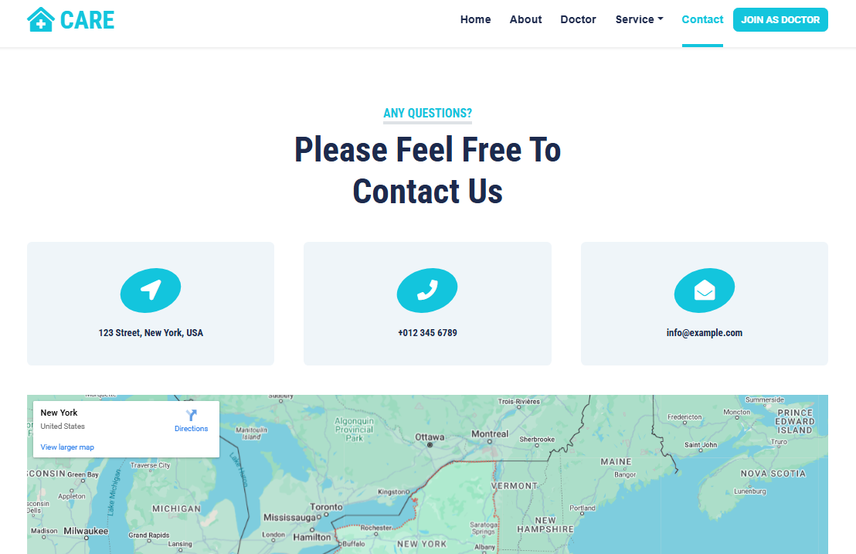
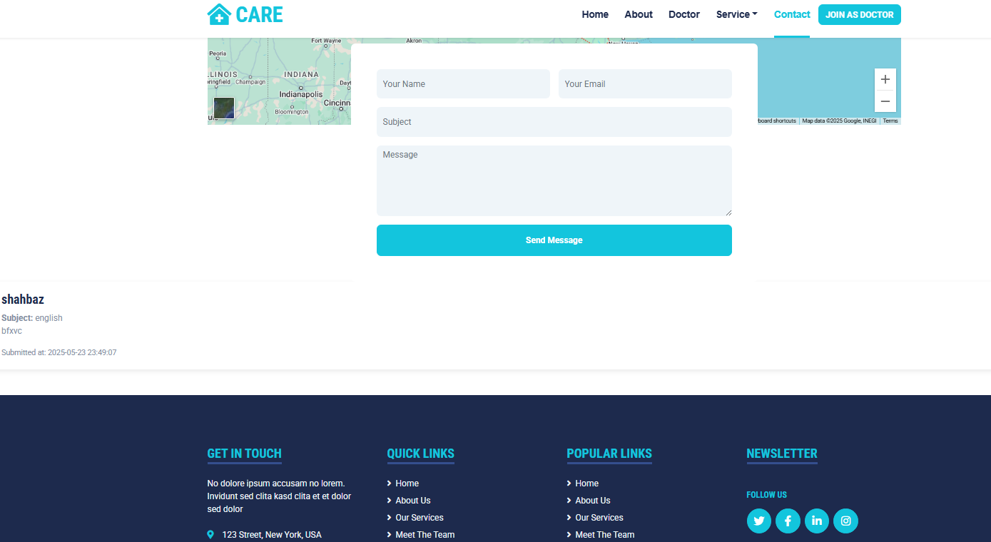
OUR CONTACT.

Slide 9
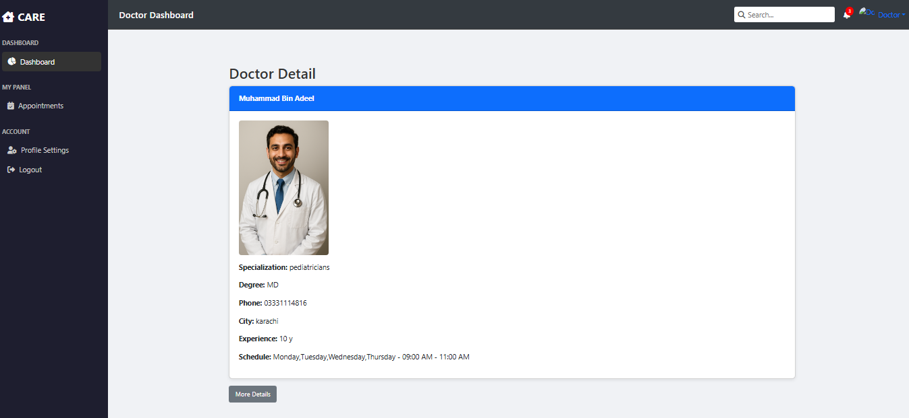
DOCTOR PANNEL.

